Slide 1
Clustering: Introduction
Unsupervised Learning

Slide 2
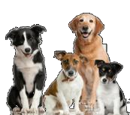
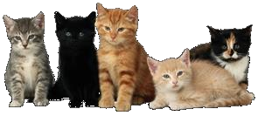
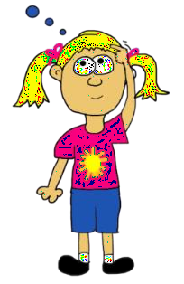
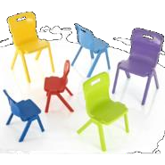

Cluster Analysis
Cluster analysis is the art of finding groups in data
In cluster analysis basically, one wants to form groups in such a way that objects in the same group are similar to each other, whereas objects in different groups are as dissimilar as possible

Slide 3
Cluster analysis
The classification of similar objects into groups is an important human activity, this is part of the learning process
i.e. A child learns to distinguish between cats and dogs, between tables and chairs, between men and women, by means of continuously improving subconscious classification schemes
This explains why cluster analysis is often considered as a branch of pattern recognition and artificial intelligence

Slide 4
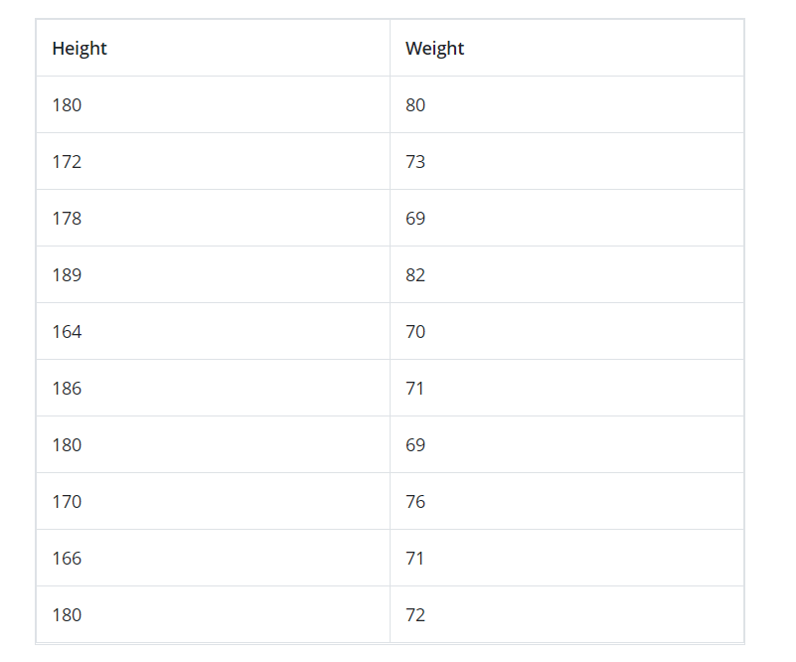
Dataset without labels

Slide 5
What is Clustering?
Clustering is dividing data points into homogeneous classes or clusters:
Points in the same group are as similar as possible
Points in different group are as dissimilar as possible

Slide 6
What is Cluster Analysis?
Given a set of objects, place them in groups such that the objects in a group are similar (or related) to one another and different from (or unrelated to) the objects in other groups
Inter-cluster distances are maximized
Intra-cluster distances are minimized

Slide 7
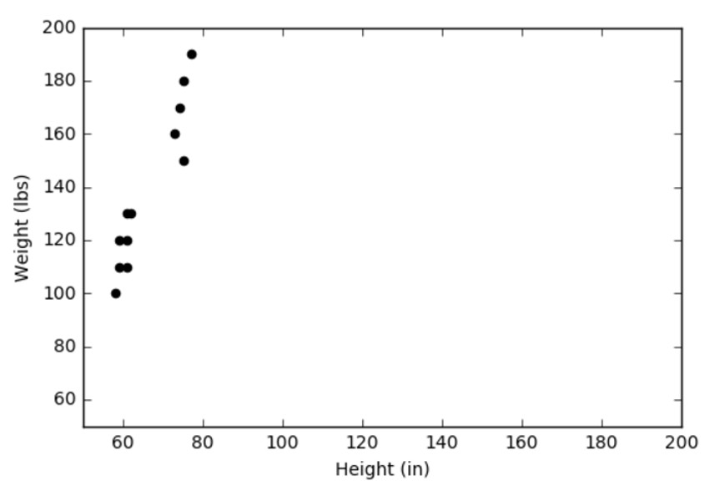
Example
Lets illustrate with the help of an example:
It is a plot of twelve objects, on which two variables were measured. For instance, the weight of an object might be displayed on the vertical axis and its height on the h
orizontal one

Slide 8
Example
Because this example contains only two variables, we can investigate it by merely looking
at the plot
In this small data set there are clearly two distinct groups of objects
Such groups are called clusters, and to discover them is the aim of cluster analysis

Slide 9
Cluster analysis
Cluster Analysis is an unsupervised classification technique in the sense that it is applied to a dataset where patterns want to be discovered (i.e. groups of individuals or variables want to be found)
No prior knowledge is needed for this grouping, and it is sensitive to several decisions that have to be taken (similarity/dissimilarity measures, clustering method,...)

Slide 10
Cluster analysis
Cluster analysis can be used not only to identify a structure already present in the data, but also to impose a structure on a more or less homogeneous data set that has to be split up in a “fair” way, for instance when dividing a country into telephone areas
Cluster a actually objects
nalysis is quite different
establishes the groups, w
to groups that were defi
from discriminant analysis in that it
hereas discriminant analysis assigns
ned in advance

Slide 11
Applications of clustering
Clustering helps marketers improve their customer base and work on the target areas. It helps group people (according to different criteria’s such as willingness, purchasing power etc.) based on their similarity in many ways related to the product under consideration.
Clustering helps in identification of groups of houses on the basis of their value, type and geographical locations.
Clustering is used to study earth-quake. Based on the areas hit by an earthquake in a region, clustering can help analyse the next probable location where earthquake can occur.

Slide 12
Applications of clustering
1. Identifying Fake News
Fake news is not a new phenomenon, but it is one that is becoming prolific.
What the problem is: Fake news is being created and spread at a rapid rate due to technology innovations such as social media. The issue gained attention recently during the 2016 US presidential campaign. During this campaign, the term Fake News was referenced an unprecedented number of times.
The way that the algorithm works is by taking in the content of the fake news article, the corpus, examining the words used and then clustering them. These clusters are what helps the algorithm determine which pieces are genuine and which are fake news. Certain words are found more commonly in sensationalized, click-bait articles. When you see a high percentage of specific terms in an article, it gives a higher probability of the material being fake news.

